Slide 1
C programming Basics

Slide 2
C is a structured programming language.
It is considered a high-level language because it allows the programmer to concentrate on the problem at hand and not worry about the machine that the program will be using.

Slide 3
Structure of C program

Slide 5
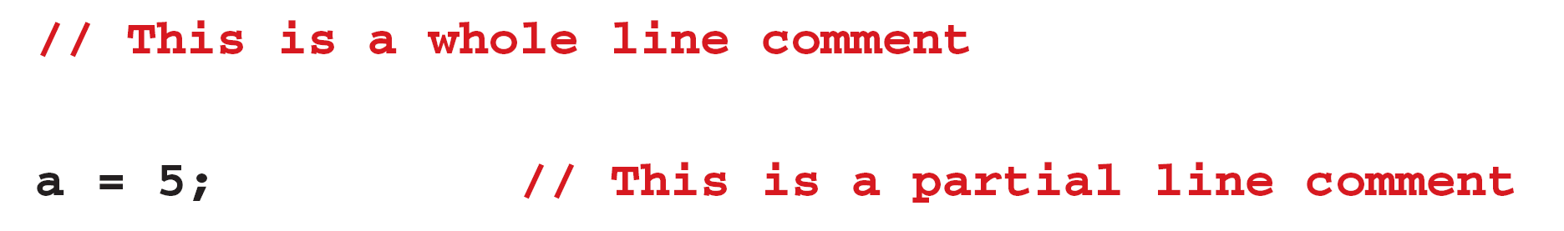

Slide 6
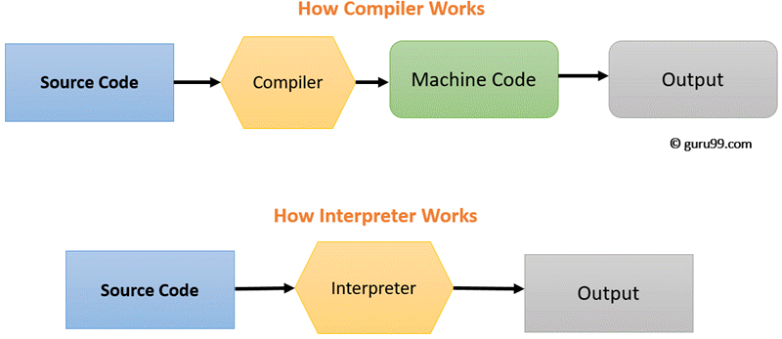
Compilation and Execution
Compiler and Interpreter

Slide 7
Key Difference:
Compiler transforms code written in a high-level programming language into the machine code, at once, before program runs, whereas an Interpreter coverts each high-level program statement, one by one, into the machine code, during program run.
Compiled code runs faster while interpreted code runs slower.
Compiler displays all errors after compilation, on the other hand, the Interpreter displays errors of each line one by one.
Compiler is based on translation linking-loading model, whereas Interpreter is based on Interpretation Method.
Compiler takes an entire program whereas the Interpreter takes a single line of code.

Slide 8
Interpreter | Compiler
Translates program one statement at a time. | Scans the entire program and translates it as a whole into machine code.
Interpreters usually take less amount of time to analyze the source code. However, the overall execution time is comparatively slower than compilers. | Compilers usually take a large amount of time to analyze the source code. However, the overall execution time is comparatively faster than interpreters.
No intermediate object code is generated, hence are memory efficient. | Generates intermediate object code which further requires linking, hence requires more memory.
Programming languages like JavaScript, Python, Ruby use interpreters. | Programming languages like C, C++, Java use compilers.

Slide 9
Compilation and Execution
Creating an executable form of your C program consists of these three steps:
1. Creating your program
2. Compiling your program
3. Linking your program with whatever functions are needed from the library

Slide 10
Library and Linking
All C compilers come with a standard library of functions that perform most commonly needed tasks. Standard C specifies a minimal set of functions that will be supported by all compilers.
However, your compiler will probably contain many other functions. For example, the standard library does not define any graphics functions, but your compiler will probably include some.
When you call a library function, the C compiler ''remembers" its name. Later, the linker combines the code you wrote with the object code already found in the standard library. This process is called linking. Some compilers have their own linker, while others use the standard linker supplied by your operating system.

Slide 11
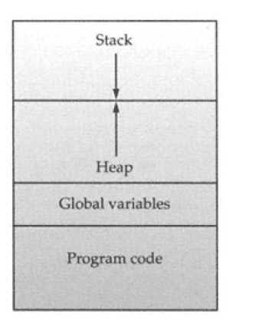
C's Memory Map

Slide 12
Words to know
Source code
Object code
Linker
Library
Compile time
Run time

Slide 13
Data types
five foundational data types: character, integer, floating-point, double floating-point, and valueless. These are declared using char, int, float, double, and void, respectively.
These types form the basis for several other types.
The size and range of these data types may vary among
processor types and compilers.
Modifying the Basic Types: Except type void, the basic data types may have various modifiers preceding them. Eg. signed and unsigned

Slide 14
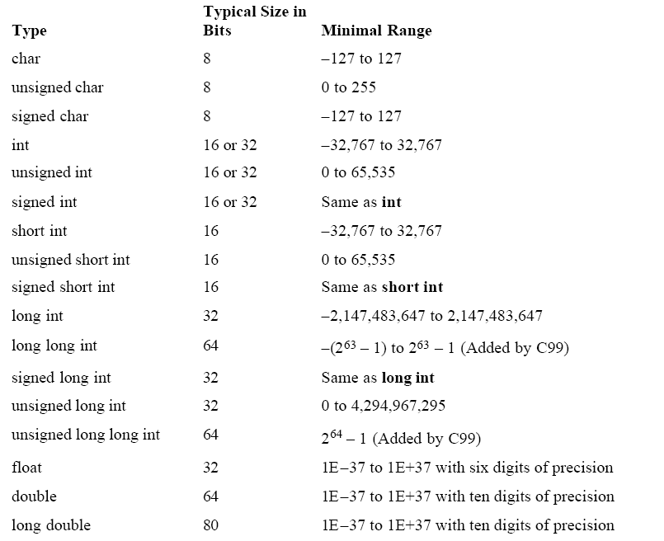
Data Types Table

Slide 15
Identifiers
An identifier must start with a letter or underscore: it may not have a space or a hyphen.
Identifiers allow us to name data and other objects in the program. Each identified object in the computer is stored at a unique address.
In C, the names of variables, functions, labels, and various other user-defined items are called identifiers.
C is a case-sensitive language.

Slide 16
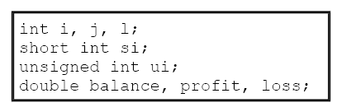
Variable
A variable is a named location in memory that is used to hold a value that can be modified by the program. All variables must be declared before they can be used. The general form of a declaration is
type variable_list;

Slide 17
Where Variables Are Declared
inside functions: local variables
in the definition of function parameters: formal parameters
outside of all functions: global variables

Slide 18
Type Qualifiers
const and volatile
Variables of type const may not be changed by your program.
const int a=10;
The modifier volatile tells the compiler that a variable's value may be changed in ways not explicitly specified by the program.

Slide 19
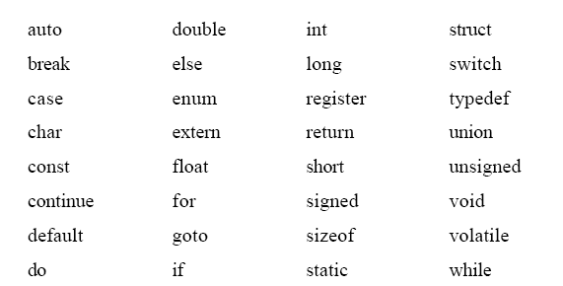

Keywords

Slide 20
C Character Set
The 26 lowercase Roman characters: a-z
The 26 uppercase Roman characters: A-Z
The 10 decimal digits:
graphic characters:
! # % ^ &amp; * ( ) - _ = + ~ ' " : ; ? / | \ { } [ ] , . &lt; &gt; $
white space characters or escape sequence characters
Space( ),Horizontal tab (\t) , Carriage return(\v), New line(\n) , form feed (\f)

